Slide 1

One Drive Realty Simple 9 Pages Educational and Recutting Custom Luxury Real Estate Website with Buildings-Products-Services that are based on educational training courses e-commerce store.
The following slides presentation are illustrative of instruction in how the landing page branding graphics will be edited and perfected including individual 9 pages drop down menu and hamburger menu that must be designed and coded as functional and operatable Hyperlinks-Redirection Pages.
The branding landing page upper and lower panels are the blueprint and the foundation functionality of our website branding and must be presented and coded perfectly.
Attention must be paid to Royal colors coordination details and must meet subliminal colors marketing and promotion psychology selling.
Every panel and every page of the website design must also meet “Post Card” design for future SMS-MMS blast marketing to recruit Agents/Affiliates/Investors/Clients.
E-commerce Products & Services Individual Hyperlink-Redirection Panels-Pages from Hamburger menu and or drop-down must be created immediately along with landing page design and coding, each panel-page with “Title” flash-image on the center as shown on the illustrative slide and as noted next .
17 Slides of informative general instruction to develop and code branding landing page.
2 Miscellaneous slides noting Royal Colors and small yacht to be utilized
All additional slides are for general detailed information to start the project.
Additional General detail information will be provided and will be a part of the project at large.
“A particularly important part of One Drive Realty is the IT person must have application design ability and deliver full "Application Design" and it includes Proprietary IDX-DFLX. and if you can achieve and deliver Proprietary IDX-DFLX software, your career may change completely with One Drive Realty Business Model.
One Drive Realty Project IDX-DFLX is an AI-assisted workspace for full-stack, multiplatform app development in the cloud. With support for a broad range of frameworks, languages, and services, alongside integrations with Google and other platforms products, IDX-DFLX streamlines our development workflow so we can build and ship apps across platforms with speed, ease, and quality.”
E-Commerce Products-Services Page-Panel Hyperlinks-Redirection Titles-Names.
As shown bellow on
Slide 9, Slide 10, Slide 11, Slide 12, Slide 13
Approximately 72 + individual Page with 3 to 6 Panel, illustrative examples are in
Slide 14, Slide 15, Slide 16 and 19
landing page must be functional, operatable and be activated as a website on it own immediately.
AI Software Engineer-Developer-Coder will provide and deliver 100% Turnkey Platform with all required contents for products and Services Including First Class Marketing and promotional Video Presentation to B2B & B2C
Real Estate YouTube Products & Services Channels
Notes:
Please read, understand and comprehend carefully the text. All and any question regarding any slide must include the slide and slide number.

Slide 2

Notes:
This photo must be photos hoped first perfectly to be background for the lancing page top panel. The mountain must be repositioned to enlarge the beach and move perfectly to center where the Real Estate Logo will be imposed on the large gray area with the birds wings just above the Cliff.

Slide 3

This is the background photo for the landing page upper panel. Center cliff mountain must be realigned to be on the center of the shot/screen using photoshop. After Centering the mountain cliff, impose OneDrive.com Logo, 9 menu tittles Flash, the decagon dot exactly as shown on following slide, the yacht photo is on it own slide , complete hamburger menu as shown bellow. When imposing the logo, make sure only the 2 Birds wings tips are exactly at the edge of the cliff mountain and the logo is centered with the rocks gray color on the back. The logo must show as emblem.

Slide 4
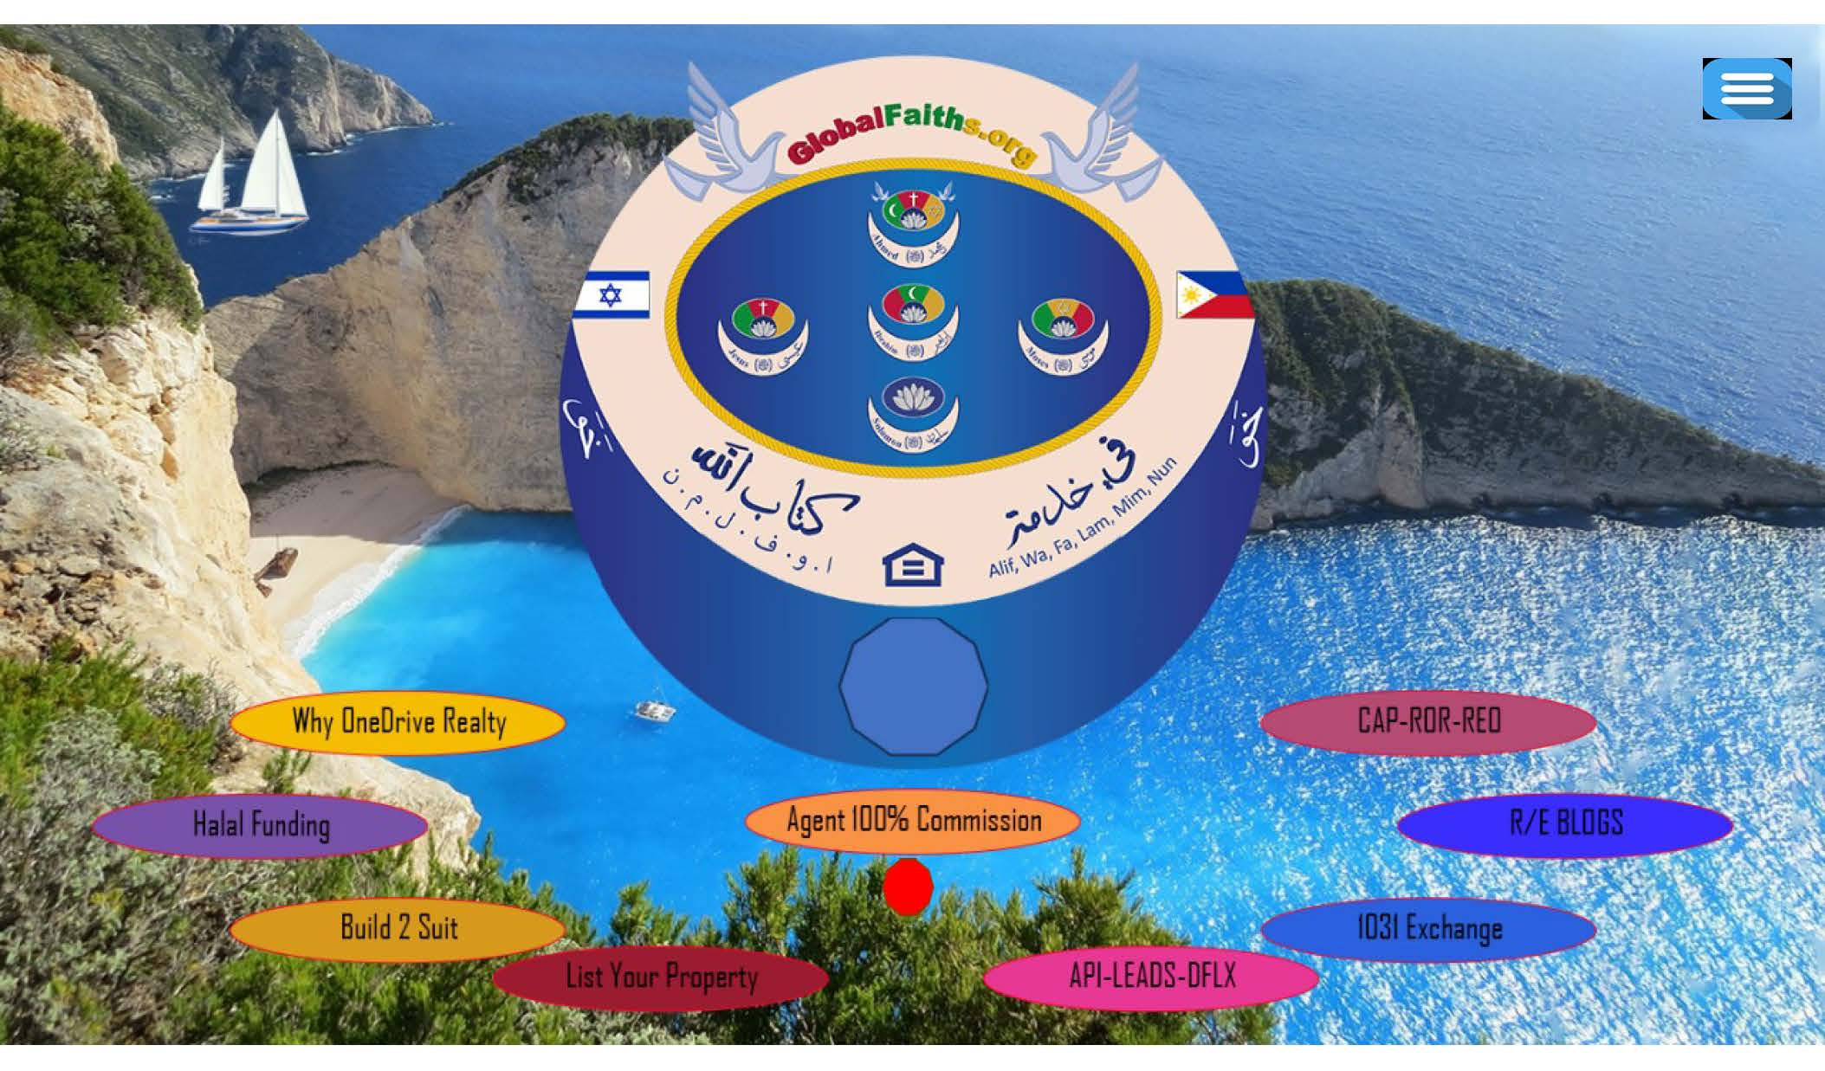
Notes:
After you edit and perfect slide 1, you will impose the Real Estate Logo Perfectly on the mountain. The 9 pages menu must be placed in a curve way perfectly spaced after you perfect ditting the shame as noted in other document.

Slide 5
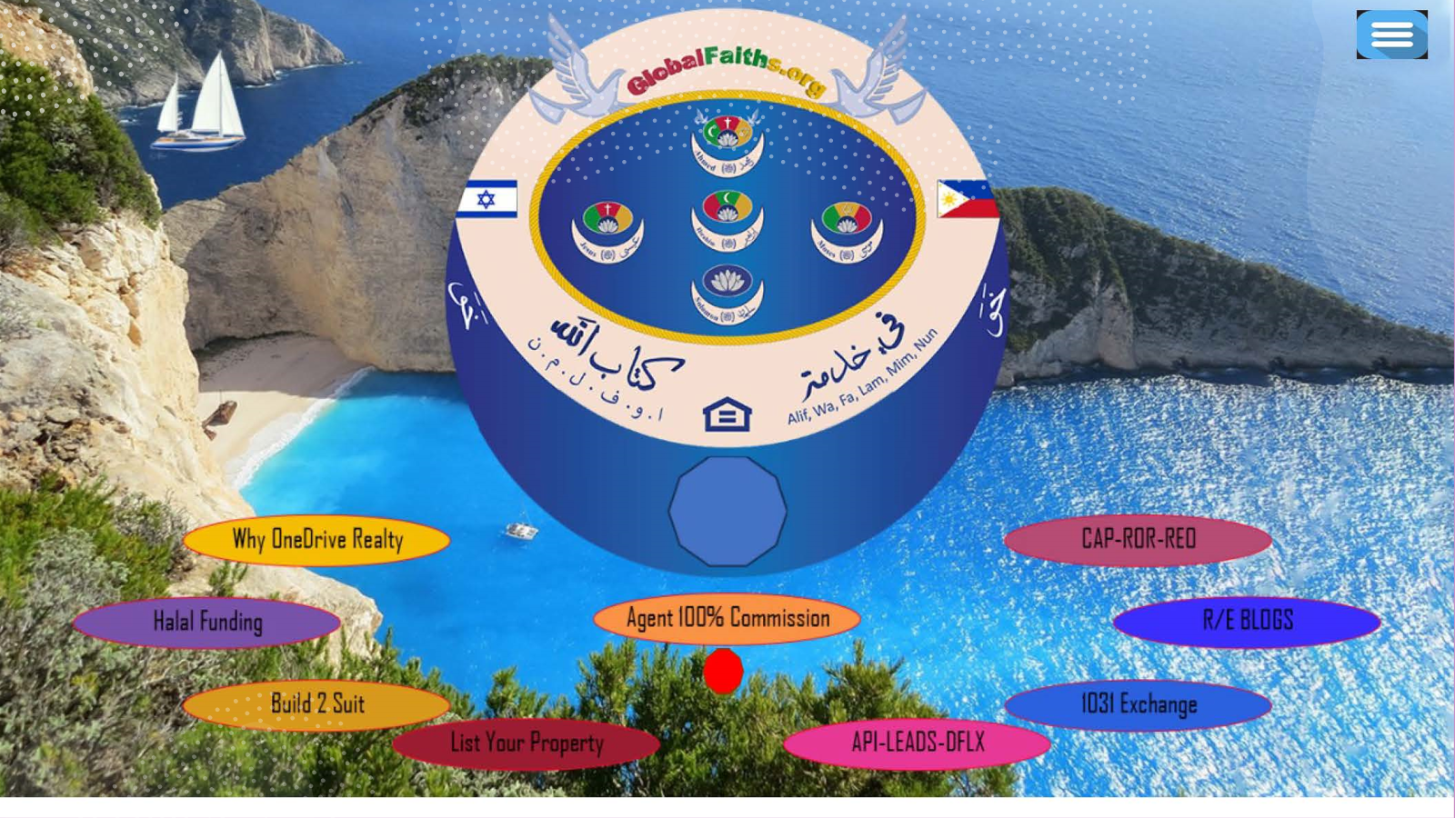
This is how the landing page upper panel view. The logo must be changed to OneDrive realty logo, the 8-flash shapes must be aligned in a curve motion, Agent100% Commission flash must be perfectly centered under the logo and the decagon under it perfectly centered use circular and rectangular grid to space and center images/shapes perfectly. Hamburger and cart just above Cap-ROR-REO to the right. Colors must be changed to Royal Colors that will fit the background ocean view. Make sure the 9 menu Items stays aligned in same order as you see them here and as instructed above.

Slide 6
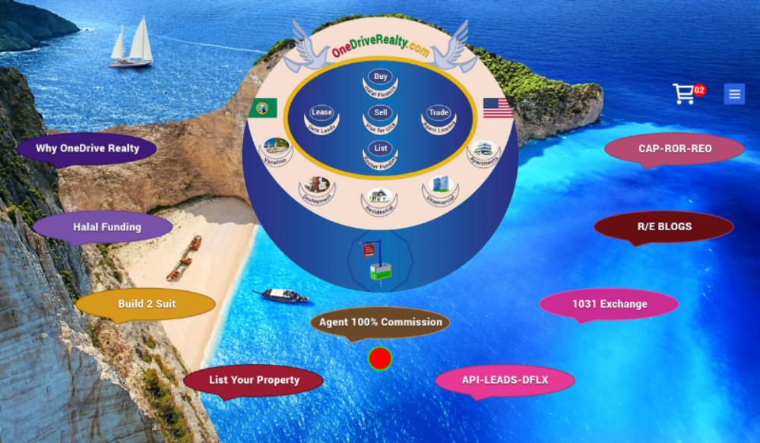
Notes:
This how the final landing page upper template should look and the flash menu title colors mix should be improved

Slide 7
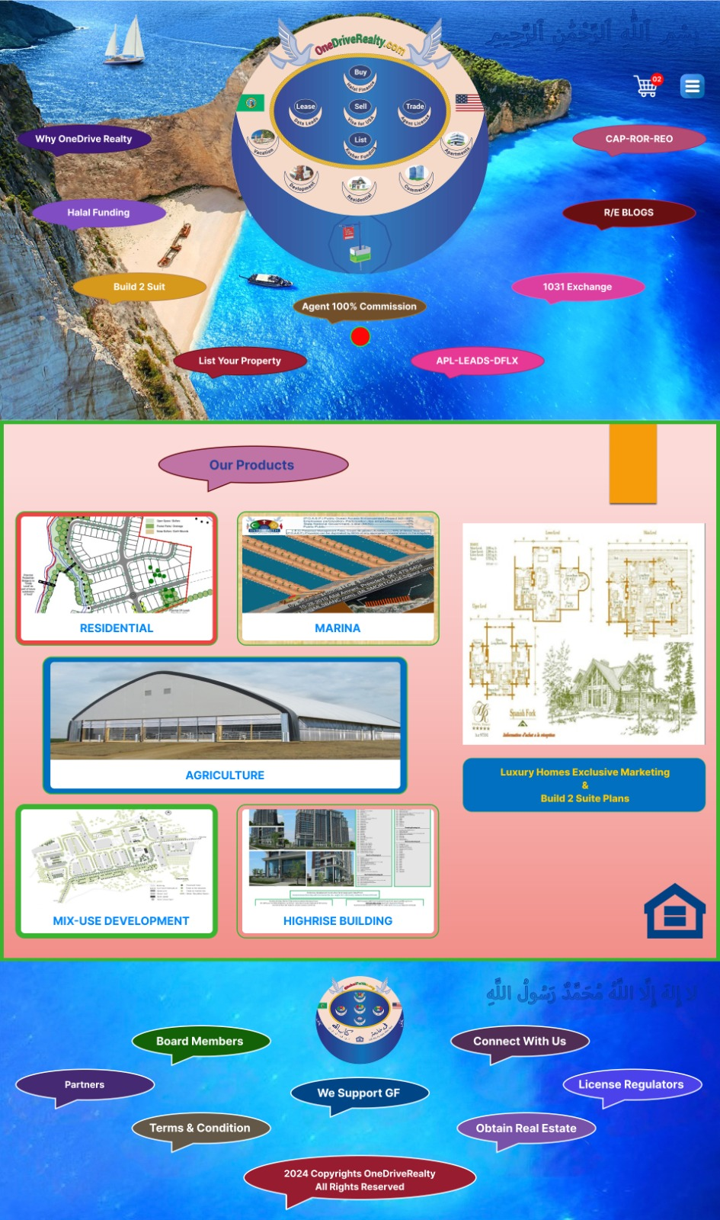
Notes:
The home/landing final look with perfect improvement to the Arabic Kalima perfected on both upper and lower panel The 6 center building products are our exclusive feature products. The nightside box with luxury residential phot will feature other luxury homes photos like video/slide presentation of all oof our residential lucury photos and these box must show in all of the website other templates

Slide 8
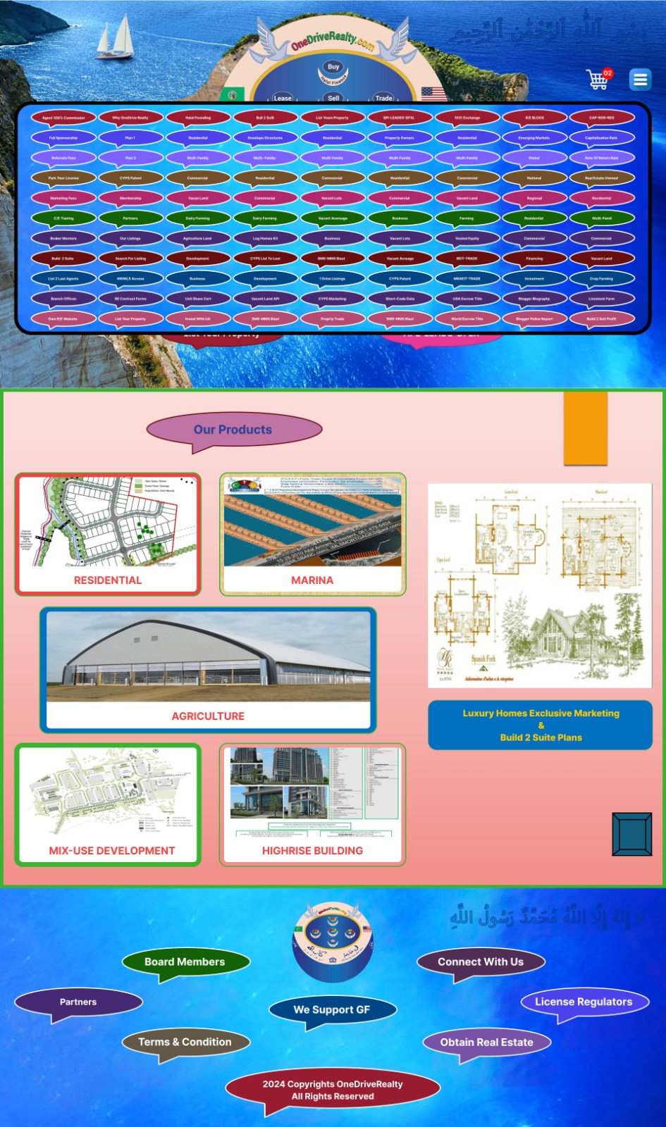
Notes:
Pay attention to the hamburger menu dropdown please, any time the visitor click on the Hamburger small icon on any of all other website panels, the hamburger menu dropdown hyplerlinks will show and the dropdown should all be hyperlinked to appropriate panel information, so the visitor will not be bored and the vistor will act upon the information they read and will participate and or purchase products or services.

Slide 9


Notes:
This Arabic KALIMA must be perfected to be embedded / sandwiched between ocean water, and it must be subconsciously readable.

Slide 10

Page 2 of 10
E-Commerce Store Products-Services Templets
Notes:
Every other website panel will have 5 or 6 boxes panels with typeset information as noted on this slide, always make sure the hypelinds on each box are actionable hyperlinks to sell products or services. Please adapt the colors coordination from the video shared with you.

Slide 11
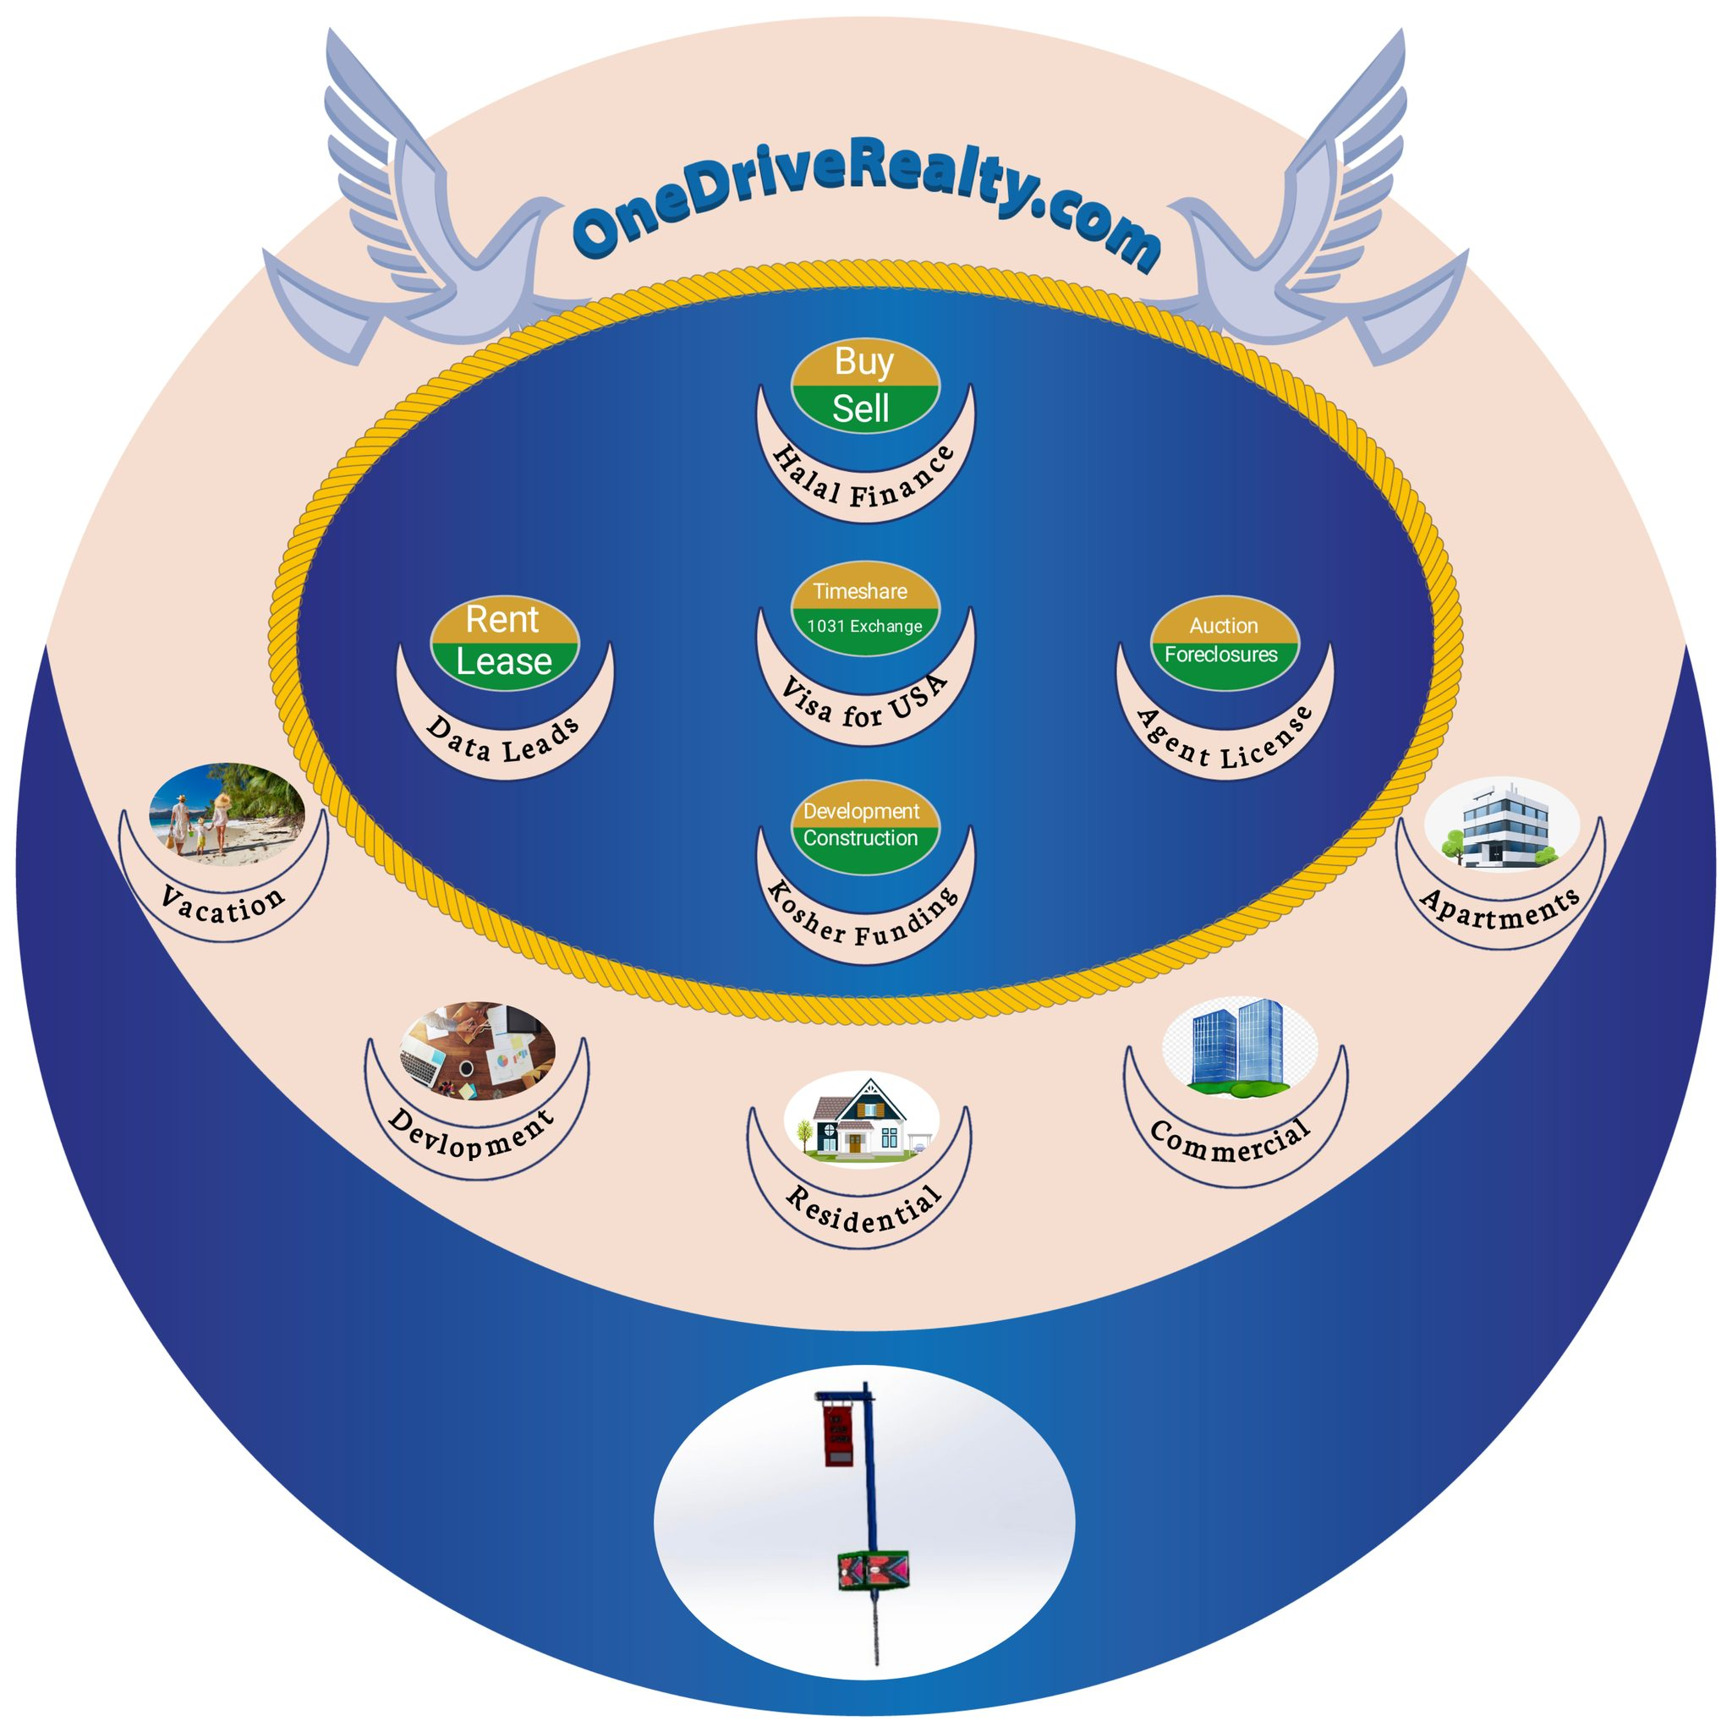
Notes:
This is temporary logo that you can use after removing white background color, and when you complete logo theme editing improvement, you will replace it with the final One.

Slide 12

This logo as shown on slide above must be used temporarily only. After you complete the logo theme sequences perfection with 2 Flags watermarks, we will use the real estate logo with 2 flags watermarks that must be coded according to States and Country Flags. The real estate logo theme will always have USA flag on the right side and USA state or country flag on the left side. Make sure the yellow and green background colors of the 5-egg shape are changed to enhance the service text shown. Make sure the size of the logo will not spool and or lose shape or defragmented or fade away under any circumstances and it must meet and fit all devices screens.
Notes:
Watch the logo theme video on the right of this slide. See more visual explanation.

Slide 13


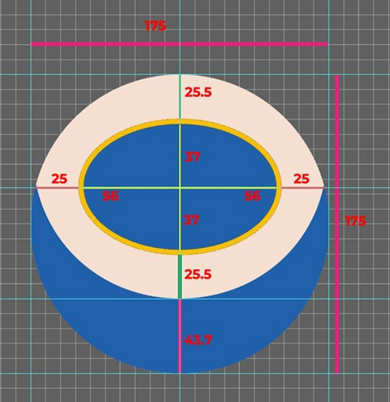



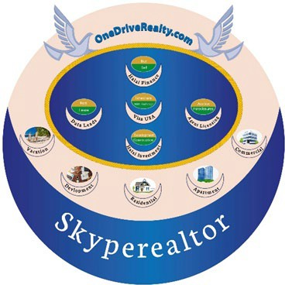
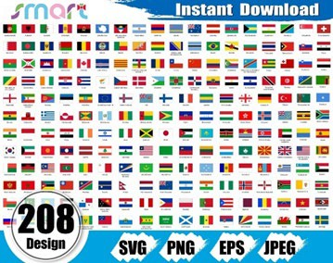
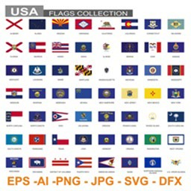



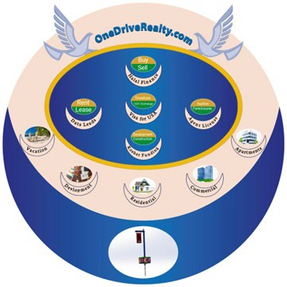
Visual instruc�ons for OneDrive Realty Graphic Design, colors and pixel coding for Landing page, logo and logo sequence’s theme and Building Products Digital Booklet Flyer branding.
Impose decagon large blue crecen perfectly.
Notes:
Every image on this slide is copy from original formatting. You must pay attention to each explaining the logo theme editing and you must use the measurement grid to complete the logo them editing and pixels blocking/coding for agents/affiliates/b2b and b2c to insert logo, country-state flags, sports team banner or simple text as shown in Arabic and English. The logo theme will have watermarks pixel spacing blocked coded to parse logo or text or photos.

Slide 14
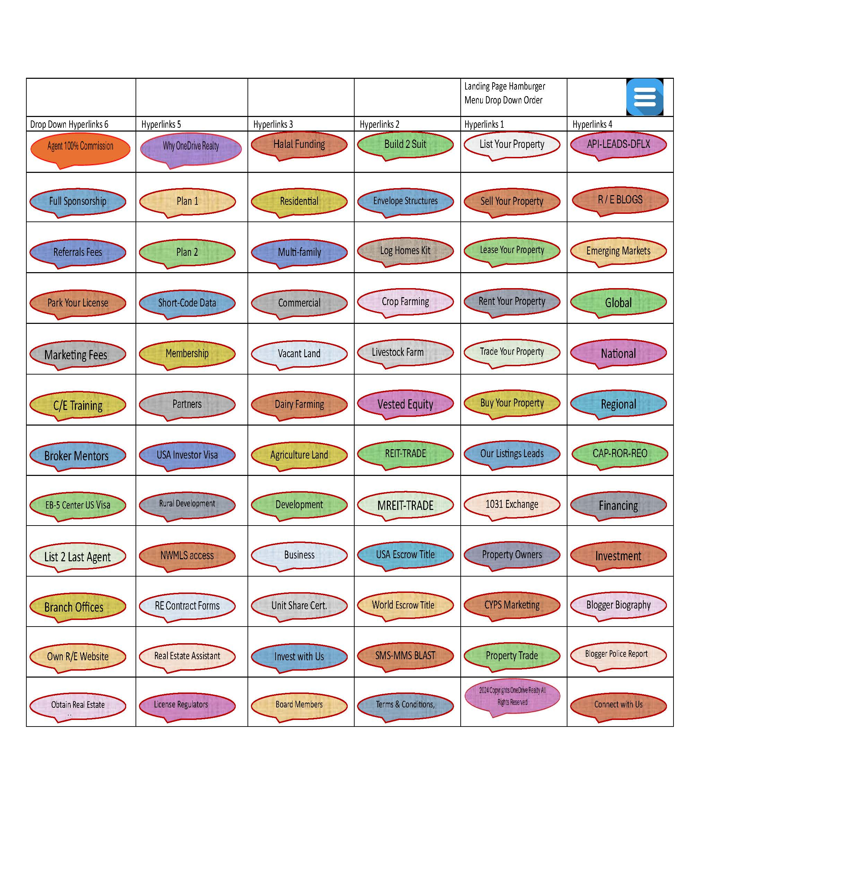
Notes:
This slide is for all products and services that will be hyperlinked when clients click on the hamburger menu. After your review products-services Presentation, you will understand. I hope this will suffice for you in how to create the e-commerce Store for all products and services pages instructions, sample is enclosed.

Slide 15

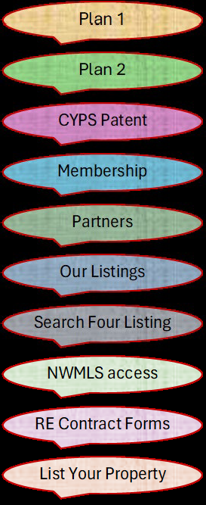
Hamburger Menu & Drop-Down hyperlinks for the 9 pages noted on the landing page upper panel.
Along with the Hemberger menu that must be designed as an L shape with perfect text and royal colors coordination presentation, this slide serves to demonstrate exactly how the 9 pages on the landing page upper panel will appear and look like and the size must fit all devices, the rest of other drop-down hyperlinks follows at the end of another file of which you will receive later. Graphic designer must add the cart next the blue hamburger icon that must be placed perfectly on the landing page. Every Item will have it own exclusive Hyperlink 8.5 x 11 page as shown on file you will receive.

Slide 16
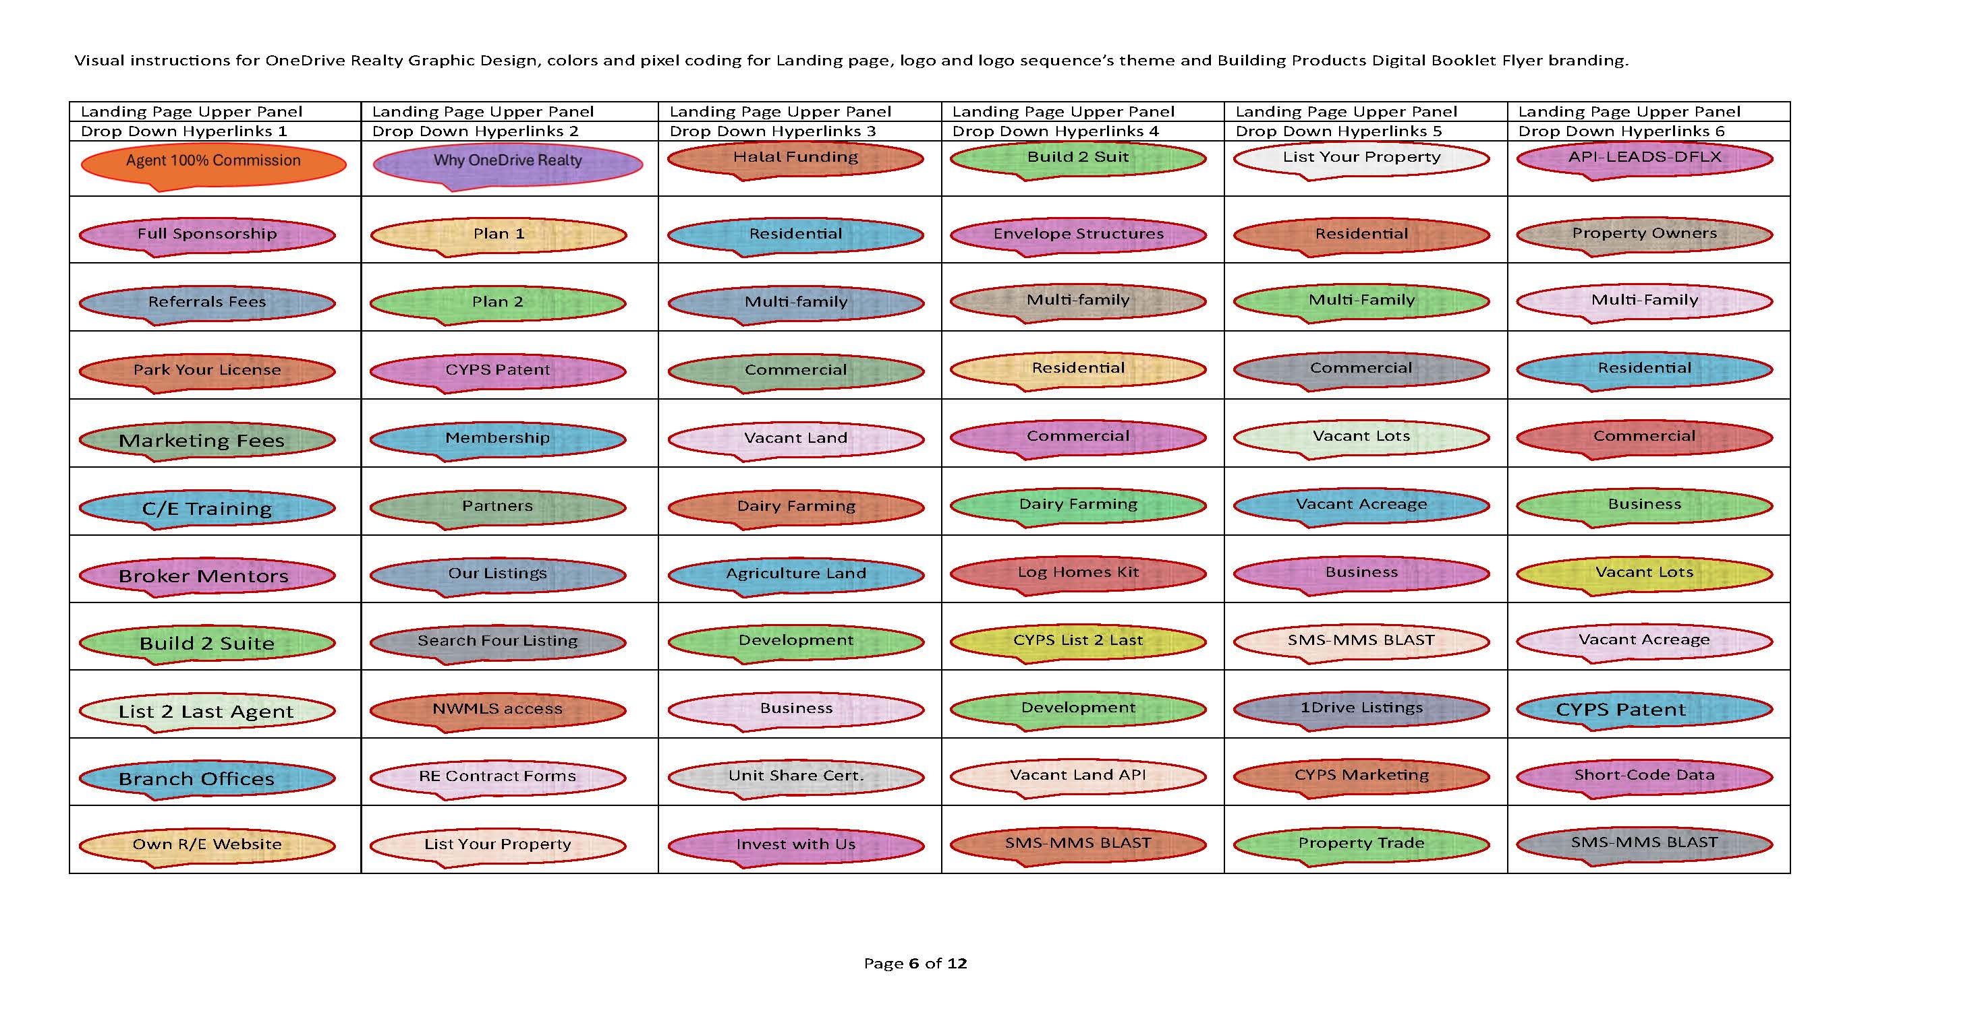
Notes:
Thes Slide and following Slide are instructions for landing page upper panel 9 Pages drop down links. Please pay attention to how each column is numbered to follow the landing page upper panel 9 menu Items.

Slide 17
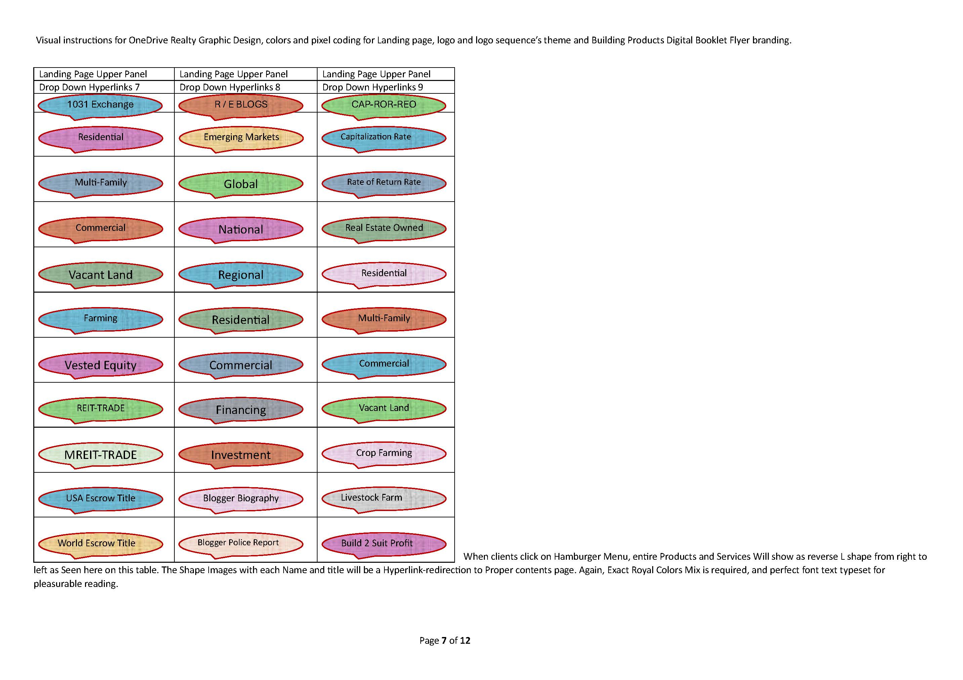
Notes:
This slide is continuation of the above slide and if you pay attention and you are creative, you will see and notice the simplicity of the graphics.

Slide 18
Notes:
This slide is for instructions of how the landing page bottom panel hyperlinks, and it must be contoured and spaced the same as the upper panel of the lancing page. Th small equal housing logo icon must be enlarged enough to be visual, and it should show just like the decagon under the flash we support GG. Board members flash to be moved to the left and connect with us should be moved to the right, and flash shapes must be of equal size and the text must be perfect and readable and enhanced. Again use perfect royal colors mix to enhance presentation and subliminal color marketing psychology.

Slide 19
Page 1 of 10
E-COMMERCE PRODUCTS & SERVICES C/E COURSES-eBOOKLETS
“This Product-Service Futures is in Progress Under Development”
Above quote be placed on every product-Service page-Panel that is not completed.
All of E-commerce Products and Services Pages-Panels Information may be as on this page and the following second page designed by IT person in much better presentation to fit all devices including as perfect “Post Card.”
The boxes with white background illustrations will include other hyperlinks functionalities to additional information and or placing the product-Service order in the Cart.
$$$ plan pricing
Hyperlink space.
Every service product page will have one of our residential luxury home photos, with information box to buy, sell, 1031 exchange link to how we market luxury home to likeminded owners with invitation only.
Our Website Goal and objectives is to promote and sell Real Estate Education, All Real Estate Services as noted on our Hamburger menu, and most importantly Build to Suit Buildings including REIT & mREIT investment and 1031 exchange nationally and globally.
Hyperlink space.
Hyperlink space.
Notes:
This Slide is for illustrative explanation sharing presentation only and it should not be construed as directive instruction.

Slide 20


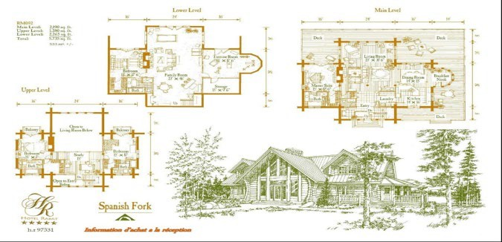
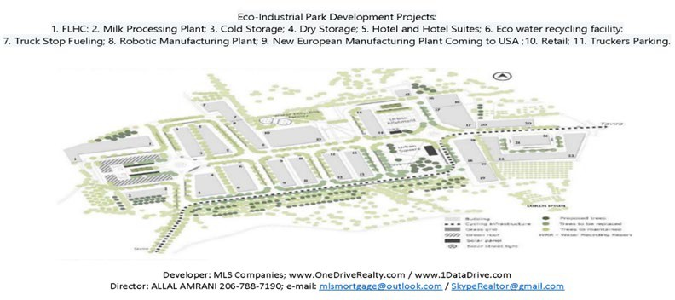
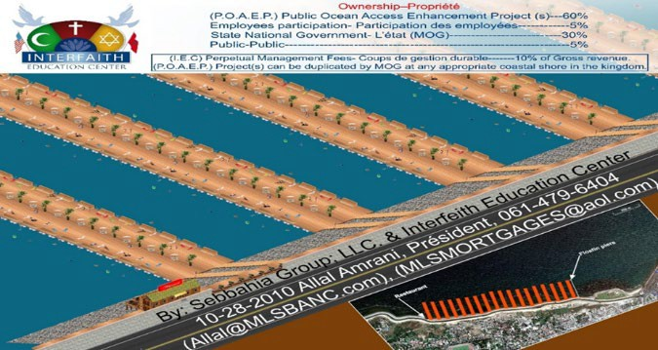
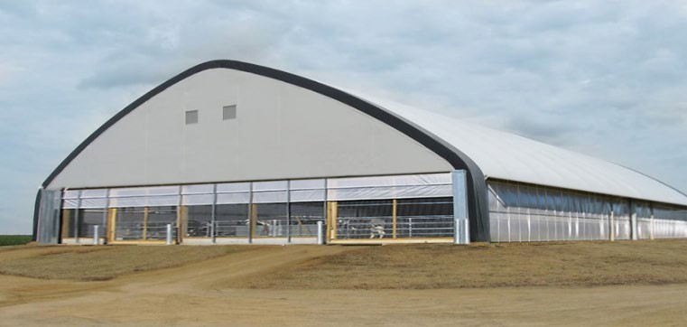

Page 3 of 10
E-COMMERCE PRODUCTS & SERVICES C/E COURSES-eBOOKLETS
Notes:
This slide if for illustration only and instruction covered above.

Slide 21
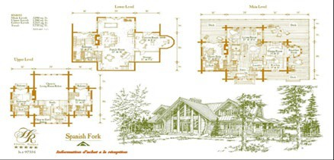

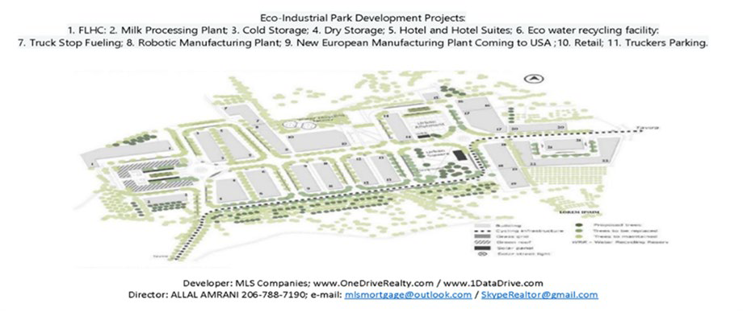

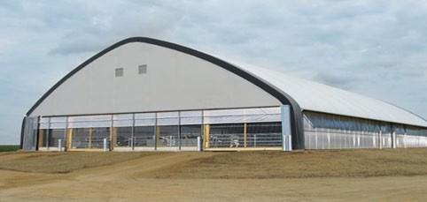

Page 2 of 10
E-COMMERCE PRODUCTS & SERVICES C/E COURSES-eBOOKLETS
Link to flip flyer-video presentation-price to buy.
Link to flip flyer-video presentation-price to buy.
Link to flyer video presentation price to buy.
Notes:
This slide if for illustration only and instruction covered above.

Slide 22
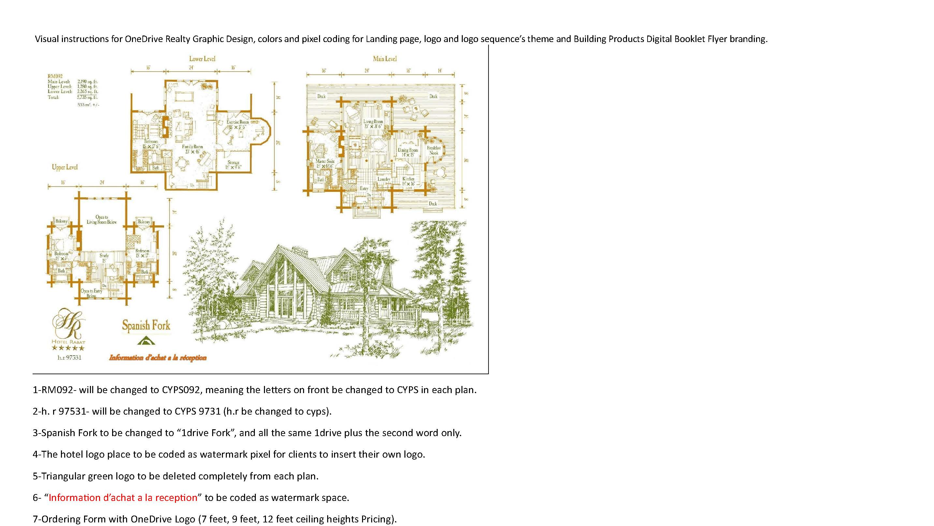
Notes:
This slide is the instruction of how the 25 Residential plans will be edited and will be presented as digital flyer flip video and slide presentation whenever required.

Slide 23
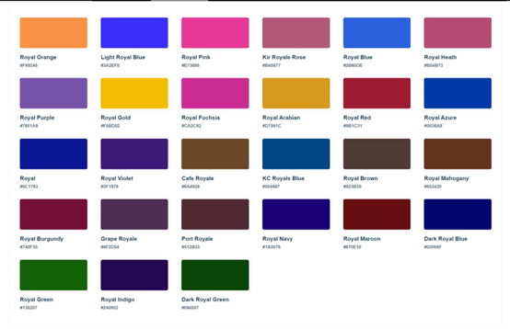
Royal Colors links
Royal Orange: #F99245 ¹
Light Royal Blue: #3A2EFE ¹
Royal Pink: #E73895 ¹
Kir Royale Rose: #B45877 ¹
Royal Blue: #2B60DE ¹
Royal Heath: #B54B73 ¹
Royal Purple: #7851A9 ¹
Royal Gold: #F5BD02 ¹
Royal Fuchsia: #CA2C92 ¹
Royal Arabian: #D7991C ¹
Royal Red: #9B1C31 ¹
Royal Azure: #0038A8 ¹
Royal: #0C1793 ¹
Royal Violet: #3F1979 ¹
Cafe Royale: #6A4928 ¹
KC Royals Blue: #004687 ¹
Royal Brown: #523B35 ¹
Royal Mahogany: #653420 ¹
Royal Burgundy: #740F35 ¹
Grape Royale: #4F2D54 ¹
Port Royale: #512B33 ¹
Royal Navy: #1A0076 ¹
Royal Maroon: #670E10 ¹
Notes:
One Drive Realty utilize subliminal colors marketing psychology, all menu shapes and products and services background colors must be deployed from this Royal Colors, the graphic designer must be proficient in color coordination presentation including Font Texts to be perfect and easy to read visually.

Slide 24


Notes:
Make sure the yacht photo and it colors are perfect before you impose it on the top panel of the landing page. It must point perfectly to the domain name between the birds.

Slide 25



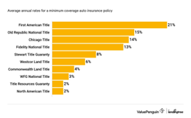
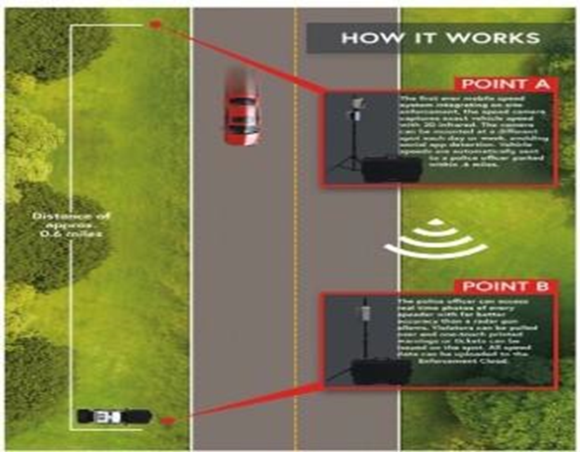
Creative Yard Post Sign Patented, Escrow-Title Digital Camera Data Relay Capturing & Transmitting Aggregated IDX-DLFX How It Works
• A Car Color & Speed captured. • B. Car Photo on Road or Next to signpost& house • C. Road Passage Speed Tax Ticket Generated • D. With GPS location & Data Relay * License Plate Number Captured. * Vehicle VIN# Captured with GPS. * Owner/Driver license# Procured. * Credit Report of Vehicle Owner Procured. * Tri Merge Credit Scores Procured. * Driver Cell Phone Procured. * Data Transmitted 2 PD dispatch alert. * Vehicle GPS Instant Location Tracked Relayed to PO. * Driver cell contact Initiated instantly by PO. * Real Estate Agent & Listing Owner Data Shared. * Local MLS Comps & Property Legal Description Procured* * Purchase Contract-Letter of Interest Populated. * * Escrow-Title Account Created, Property Title Copy Procured & 1003 Loan-Funding * Application Populated. * * Billing Invoice for e-singing Instantly emailed via certified SMS-MMS. | * Commercial Title Insurance: Provides protection against losses from certain title issues for transactions of all sizes and complexities. * Commercial Escrow and Settlement Services: Third Party Escrow-Title Firm Serves as a neutral third party to close transactions based on the terms of the contract and its amendments. * ALTA Land Title Surveys: Ensures comprehensive title policies and identifies, reviews, and addresses exceptional matters. * Express Esri-GIS Map® Services: Utilizes current aerial photography to create an innovative and cost-effective underwriting tool. * Flood Services: Delivers FEMA flood elevation certificates to establish elevations of improvements in special flood hazard areas. * Commercial Zoning Services: Provides zoning reports backed by years of knowledge and experience. * Energy Services: Offers customized land title services and title insurance solutions for complex energy transactions. * International Services: Provides title insurance and a broad range of property and mortgage-related services to corporate clients and consumers worldwide. * Foreclosure: Specialized foreclosure services to handle all elements of the pre- foreclosure and foreclosure process. * 1031 Exchange Services: Empowers investors to preserve equity and save tax dollars through tax-deferred exchanges. * UCC Insurance: Offers full UCC search services combined with indemnity insurance.
Notes:
Stakeholders Company Partners: Title & Escrow, Real Estate Firms/Agents, Government Agencies

Slide 26

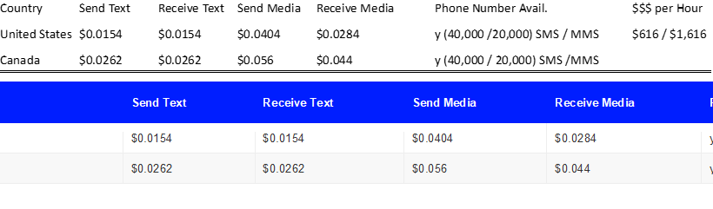
100% Commission Real Estate Sponsorship & CYPS Pre-Lease Programs Pricing.
CRPS Pre-Lease Commitment & Agents Sponsorship Fees
MONTHLY & ANNUAL ENGAGEMENT PAYMENTS COMMITMENT ***
Contract TERMS | Monthly | One YEAR | Three YEARS | Five YEARS
100% Sponsorship | $176.00 Per month | $149.60 Per month | $140.80 Per month | $132.00 Per month
IDX-DLFX | $90.00 Per month | $82.00 Per month | $76.50 Per month | $72.00 Per month
Website + E-Mail | $160.00 Per month | $144.00 Per month | $136.00 Per month | $128.00 Per month
1 Creative Yard Post Sign Unit (Pre-Lease) | $190.00 Per month * | $171.00 Per month * | $161.50 Per month * | $152.00 Per month *
5 Creative Yard Post Sign Units (Pre-Lease) | $950.00 Per month * | $855.00 Per month * | $807.50 Per month * | $760.00 Per month *
Total Advance Payment
Estimated Pricing Only. Pricing will change per Carrier charges +
API Database Leads Agent-Client Provides. API Database Leads If We Provide, Pricing Applies per set requested.
Notes:
Stakeholders Washington State Active & Inactive Real Estate Licensees.

Slide 27
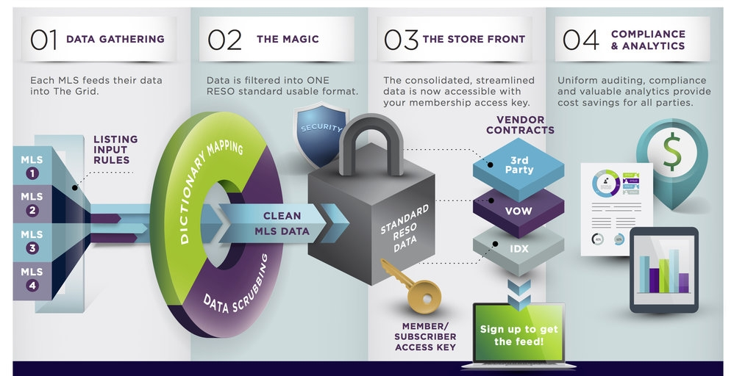
Notes:
CYPS-IDX-DFLX proprietary software application from camera to MLS to Advertising Agencies website and so on.

Slide 28
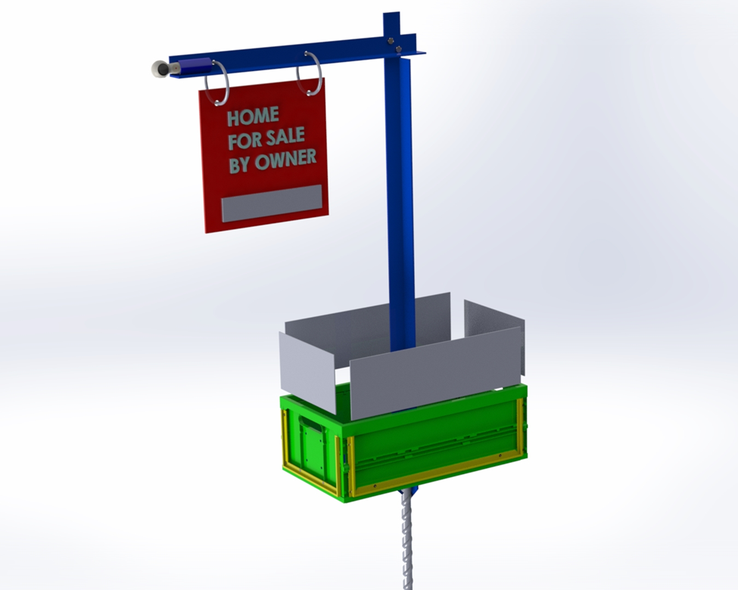

CYPS advertising 4 screens Integration to IDX
Notes:
This screen is an illustration of how CYPS application software will be coded and integrated to IDX-DFLX. Electronic relay box screens.

Slide 29
1
Full Stack Website Developer IT coding skills expertise required.
Must be proficient with all required Adobe Applications to complete the Real Estate Website.
Luxury recruiting real state first class website development and logo-sequences Improvement: Graphic Designer - UI/UX Designer, Web Developer and Software Engineering.
Experienced with proficiency in the followings:
Miniature Logo Branding & Graphic Design Website Design Icon Design Business card Design Flyers Infographic Design Products and Services Video Presentation Brochure Design Catalog Design Software Application Design and coding.
www.OneDriveRealty.com
Html, CSS, bootstrap, jQuery (client-side programming language). Themes and Functionalities to adaptation from these Two Websites:
http://www.globallistings.com/ & https://100agents.com/
Second Recruiting Website theme exactly like this website: https://www.thevirtualrealtygroup.com/
Html, CSS, bootstrap, jQuery (ABSOLUTELY NO WORDPRESS PERIOD)
HTML, CSS, Bootstrap, and jQuery are all web development technologies that are used to create and design websites. Here is a brief overview of each technology:
HTML (Hypertext Markup Language) is the standard markup language used to create web pages. It provides the structure and content of a website.
CSS (Cascading Style Sheets) is a stylesheet language used to describe the presentation of a document written in HTML. It provides the style and layout of
a website.
Bootstrap is a popular open-source CSS framework that provides pre-built components and styles for creating responsive and mobile-first websites. It is built on top of HTML, CSS, and JavaScript.
jQuery is a fast, small, and feature-rich JavaScript library that simplifies HTML document traversing, event handling, and animating for rapid web
development.
HTML Tutorial
CSS Tutorial
Bootstrap Documentation
jQuery Documentation
Notes:
Slide 25 thru slide 28 includes expertise of IT Freelancer service Provider.

Slide 30
2
client-side programming language
Client-side programming languages are programming languages that run on the client- side of a web application. They are used to create interactive user interfaces and dynamic web pages. Some of the most popular client-side programming languages include JavaScript, HTML, CSS, jQuery, React, Angular, Vue, SASS, Elm, and Swift ¹.
JavaScript is a fast, lightweight, and cross-platform scripting language that is used to create interactive web pages and web applications. It is widely used for client-side scripting, server-side scripting, and game development ¹.
HTML (Hypertext Markup Language) is the standard markup language used to create web pages. It provides the structure and content of a website ¹.
CSS (Cascading Style Sheets) is a stylesheet language used to describe the presentation of a document written in HTML. It provides the style and layout of a website ¹.
jQuery is a fast, small, and feature-rich JavaScript library that simplifies HTML document traversing, event handling, and animating for rapid web development ¹.
React is a popular JavaScript library for building user interfaces. It is used to create reusable UI components and manage the state of a web application ¹.
Angular is a TypeScript-based open-source web application framework that is used to build dynamic web applications. It provides a set of pre-built components and tools for building complex web applications ¹.
Vue is a progressive JavaScript framework that is used to build user interfaces and single-page applications. It is designed to be incrementally adoptable and can be easily integrated into other projects ¹.
SASS (Syntactically Impressive Style Sheets) is a CSS preprocessor that is used to simplify and extend the functionality of CSS. It provides features such as variables, nesting, and mixins that are not available in CSS ¹.
Elm is a functional programming language that is used to build web applications. It is designed to be easy to use and provides features such as type inference, immutability, and purity ¹.

Slide 31
3
Swift is a powerful and intuitive programming language that is used to build iOS, macOS, watchOS, and tvOS applications. It is designed to be safe, fast, and interactive ¹.
watchOS is an operating system developed by Apple Inc. for the Apple Watch, a digital smartwatch ¹². It is based on iOS, the operating system used by the iPhone, and has many similar features and frameworks ¹. The watchOS platform focuses on
distributing entertainment and gaming apps and acts as a window to all of Apple’s service platforms, including Apple TV+, Apple Arcade, Apple Music, and HomeKit ³.
The latest version of watchOS as of November 2023 is watchOS 17 ⁴. It was released on September 18, 2023, and brought new features such as FaceTime on Apple Watch 4K, redesigned Control Center, Siri Remote locator, and expanded functionality with Siri ⁴.
-------
tvOS is an operating system developed by Apple Inc. for the Apple TV, a digital media player ¹. It is based on the iOS operating system and has many similar frameworks, technologies, and concepts ¹. The tvOS platform focuses on distributing entertainment and gaming apps and acts as a window to all of Apple’s service platforms, including Apple TV+, Apple Arcade, Apple Music, and HomeKit ².
The latest version of tvOS as of November 2023 is tvOS 17 ³. It was released on September 18, 2023, and brought new features such as FaceTime on Apple TV 4K, redesigned Control Center, Siri Remote locator, and expanded functionality with Siri
3.
If you are looking to create a real estate platform using HTML, CSS, Bootstrap, and jQuery, there are many resources available online that can help you get started. Here are some resources that you might find useful:
GitHub: You can find many open-source projects on GitHub that can help you build a real estate website. For example, the property_web_builder project is a fully featured real estate website builder that you can use to create a website on Rails in minutes.
Dev.to: You can find many tutorials on Dev.to that can help you build a real
estate website using HTML, CSS, and JavaScript. For example, this tutorial shows you how to create a real estate website using HTML, CSS, and JavaScript.
FreshDesignWeb: You can find many real estate website templates on FreshDesignWeb that you can use as a starting point for your project. For

Slide 32
4
example, the Reland template is a real estate group HTML template designed for selling properties like villas, land, apartments, houses, and more.
😊==========================
API leads from NWMLS
API Leads is a simple interface to manage leads. A lead represents an individual or an organization that expresses interest in your goods or services. You can assign an organization to an individual via the organization name field. The API allows you to create, read, delete, and update your leads. Leads are potential deals stored in Leads Inbox before they are archived or converted to a deal. Each lead needs to be named (using the title field) and be linked to a person or an organization. In addition to that, a lead can contain most of the fields a deal can (such as value or expected_close_date) ¹.
https://webdesign.tutsplus.com/building-an-api-driven-web-app-with-html-and-css-- cms-24575t
If you want to create a CRUD website with HTML, CSS, JavaScript and an external API, you can follow this tutorial ². This tutorial will guide you through creating a web application with basic HTML, CSS, and JavaScript (based on Bootstrap 5) to perform CRUD operations. CRUD operations are the four basic operations of manipulating data including Create/Construct, Read, Update and Delete. Furthermore, the CRUD operations will be performed by the use of an external API from MeCallAPI.com ².

Slide 33
One Drive Realty Firm
Real Estate & Real Estate Logistics Digital Boutique Firm.
Staff & Agents Recruits Onboarding
Affiliate / Agent, you are embarking on an incredibly challenging career to launch Digital Real Estate and Real Estate Logistics Starting Career in a real estate & Real Estate Logistics business that is both exciting and challenging. Here are some essential steps to help you pave the way to Your / Our professional challenge success with IEC dba Global Faiths & OneDrive Realty.
Think Through Your / Our Professional Goals with One Drive Realty Firm:
Evaluate Your / Our personal, professional, and financial goals. Consider where you want to be in the next five, ten, and fifteen years with One Drive Realty Firm. These goals will shape Your / Our business executive position strategy and decisions to succeed with Your / Our business model.
Conduct Ongoing and perpetual In-Depth Research:
Understand the Digital real estate market nationally (USA), Globally and Your / Our own local area. Study local, national (USA) and global trends, property values, and demographics. Research Your / Our competitors and find gaps or opportunities that fit Your / Our business model and Your / Our residential and commercial buildings development and Build to Suit market space including Real Estate Logistics and Data Leads Markets.
You are a part of Organizing team for Your / Our Revenue and Finance:
To Determine running costs, including licensing fees, marketing expenses, and office expenses. Create a budget and explore financing options as may be needed and needed to streamline Your / Our operation.
Craft Your / Our Own Executive Business Strategy in relation to Stakeholders:
Develop a detailed location marketing / business road map. Define target
market, services, pricing, and marketing approach for each of Your / Our clients. Set clear aims and milestones for Your / Ourselves and Your / Our consultants.
Ongoing Zoning laws Research:
Consider creating a properties legal research learning for Your / Our executive career position with One Drive Realty, such as Consulting
Notes:
This Slide thru following slides with 2 logos are part of contents for Agents/Affiliates Onboarding disclosure.

Slide 34
with online Zoning laws information, and when necessary, consult with local attorney or business advisor consultant when needed for Your / Our potential Clients and prospects, choose third party consultants wisely.
You are collaborator for Your / Our perpetual marketing plan:
To Build a consistent marketing plan. Utilize online and offline channels to reach potential clients, recruits, and investors. Invest in Your / Our business model branding, social media, and networking.
One Drive Realty websites:
You will Establish Your / Our online digital presence and Your / Our e- commerce stores. Pre-launch Your / Our first-class luxury professional website that will display Your / Our services, Your / Our building products, Your / Our listings, Your / Our own IDX, and abilities. Your / Our website platform will be and must be and you will Make it user- friendly and mobile-responsive.
One Drive Realty Prospect Consistently with Your / Our SMS & MMS Modem:
Regularly seek new leads in Your / Our actionable market access.
Network with other professionals, attend industry events when called for by Your / Our CEO, and use customer relationship management (CRM) tools to manage contacts, leads and Your / Our clients.
One Drive Realty Executives and Staff will Nurture Leads:
All staff will follow up with leads promptly. Supply valuable information, answer questions, and build relationships. Consistent follow-up is crucial for the conversion of Your / Our Agents / Brokers / Investors / Buyers / Sellers recruitment leads and all leads.
One Drive Realty Executives and Staff will Stay on Top of Leads:
All staff will use technology to track leads, automate follow-ups, and stay organized. Leverage CRM systems to streamline communication and lead management. Your / Our SMS & MMS modem must be used to it maximum for all revenue monetizing venues (Agents/Investors/Services/Buildings/Development/Products).
Remember, succeeding as an executive in Your / Our digital real estate & real estate logistics business model requires dedication, planning, and persistence. Deploy Your / Our right mindset and strategic approach, and you and future staff can build a successful career with One Drive Realty in this dynamic industry. 🏡

Slide 35
One Drive Realty is a member with access to actionable real estate and mortgage lead Markets locally and nationally.
One Drive Realty supplies actionable real estate & mortgage leads.
Total Vacant Land in Washington State 3,333,064
What is Real Estate Lead?
A real estate lead refers to the name and contact information of a person who is interested in buying or selling a property. Real estate leads can be generated through various means such as social media advertising, referrals, and campaigns. Real estate lead generation companies use technology, advertising skills, and professional staff to generate leads for realtors, teams, and brokerages. These companies place ads on
social media platforms and search engines to capture a buyer or seller’s contact information. Real estate leads can vary in interest level and are typically classified as
cold, warm, or hot. Real Estate agents / brokers / developers / Investors are perpetually looking for lead generation companies.
The cost per real estate lead varies depending on the lead generation method. According to Sierra Interactive, the average cost per lead in the real estate industry is around $20. However, the cost per lead can range from $1 to $35 depending on the location and the lead generation company requirements. here are some of Your / Our best competitors’ companies for 2023.
Market Leader: Offers exclusive leads and affordable social media leads.
CINC: Supplies hyperlocal leads.
zBuyer: Offers affordable leads with no contract.
Smart Zip: Supplies seller leads.
Catalyze AI: Offers exclusive inherited property leads.
REDX: Supplies prospecting leads.
Real Geeks: Offers the most affordable all-in-one lead generation system.
Zillow Premier Agent: Supplies buyer leads.
What is a Mortgage Lead?
A **mortgage lead** is a person who has expressed interest in obtaining a mortgage loan. Mortgage leads can be generated through various means such as online advertising, referrals, and campaigns. Mortgage lead generation companies use technology, advertising skills, and professional staff to generate leads for lenders and

Slide 36
loan officers. These companies place ads on social media platforms and search engines to capture a borrower's contact information. Mortgage leads can vary in interest level and are typically classified as cold, warm, or hot.
The cost of mortgage leads can vary depending on the lead generation company and the type of lead. The cost of a single mortgage lead can range from **$1 to $500 ** However, this cost does not take into consideration the time and effort needed to cultivate and convert those leads into borrowers.
Here are some of Your / Our best competitors’ companies in Mortgage leads for 2023.
1. **LendingTree**: 2. **Zillow**: 3. **Quicken Loans**: 4. **Bankrate**: 5. **Rocket Mortgage**:
IEC dba GLOBAL FAITHS FINANCIALY SOVEREIGN NGO REAL ESTATE & REAL ESTATE LOGISTICS B2B & B2C
NEW OUTSYOUR / OURCING IT BUSINESS OPERATION NATIONALLY & GLOBALLY
New business Operation in Local market for global support, IEC dba Global Faith consider the following business support service ventures ideas that are associated with Your / Our national and global Business Model.
***Real estate investment: Halal Real estate investment is a profitable business in Local market and globally. Investing in commercial or residential properties can earn a good return on investment.
We will offer 100% turnkey development and construction consultation services including architecture and construction blueprint, take off cost, Hallal RE* Investment- Financing requires a significant amount of IP and equity capital to start ¹.
Transportation Logistics. CDL training & Trucking Drivers Dispatch Service.
We will be offering Dispatch services remotely from Local market and other locations 24/7.
Drop shipping: Drop shipping is a low-risk business model that allows to sell products support service online without clients having to keep inventory.
We will start by creating an online store and partnering with suppliers who will ship the products directly to Your / Our B2B & B2C customers ¹.
Digital Marketing Services: Digital marketing services are in high demand globally and in Nationally.
We will offer services such as social media marketing, search engine optimization, content marketing and cloud based accounting forecast software to businesses and individuals ¹.

Slide 37
Print-on-demand t-shirts-Garments & Advertising Souvenirs Products: Print-on- demand t-shirts and garments are becoming increasingly popular globally and in Nationally.
We created Your / Our own designs and we will sell them online through platforms such as Amazon, Etsy, or Shopify ¹.
Graphic Designing: Graphic designing is another high-demand service globally and nationally.
We will be offering services such as logo design, branding, web design, short-code and print design to businesses and individuals especially Real Estate Professionals¹.
E-commerce Store: E-commerce stores are becoming increasingly popular globally and in Nationally.
We will be creating an online store that sells souvenirs and advertising co-branding standalone logo and logo sequences gift products such as clothing, electronics, home appliances and consumers packaging¹.
“Fiduciary relationship is one in which an individual owes another a fiduciary duty to act in the other’s
interest. This duty arises regardless of the parties’ intent and is characterized by trust, confidence, and honesty.”
"Fiduciary" is a term that can be used as both a noun and an adjective. As a noun, it refers to a person or organization that has the power and obligation to act for another person or persons, putting their clients' interests ahead of their own, with a duty to preserve good faith and trust ³. For example, a financial advisor who is a fiduciary is legally and ethically bound to act in the best interests of their clients ³. As an adjective, it describes something that involves trust, especially regarding the relationship between a trustee and a beneficiary ¹. “
“Employees, including at-will employees, owe **fiduciary duties** to their employers. This is because all employees are considered "agents" of their employers and have a fiduciary duty to act loyally for the principle's (the employer's) benefit in all matters connected with the agency relationship ¹. “
The duty of loyalty includes the following aspects:
The employee will not compete with their employer.
The employee will not solicit the employer's customers, clients, or employees prior to leaving the company.
The employees will not use work time to further their own interests.
The employee will not misappropriate confidential information or trade secrets of the employer by sharing that information with new employers.
The employee will account for profits and deal fairly with their employer in all transactions between them.
The employee will disclose the existence of conflicts or adverse information to the employer ¹.

